Slide 1
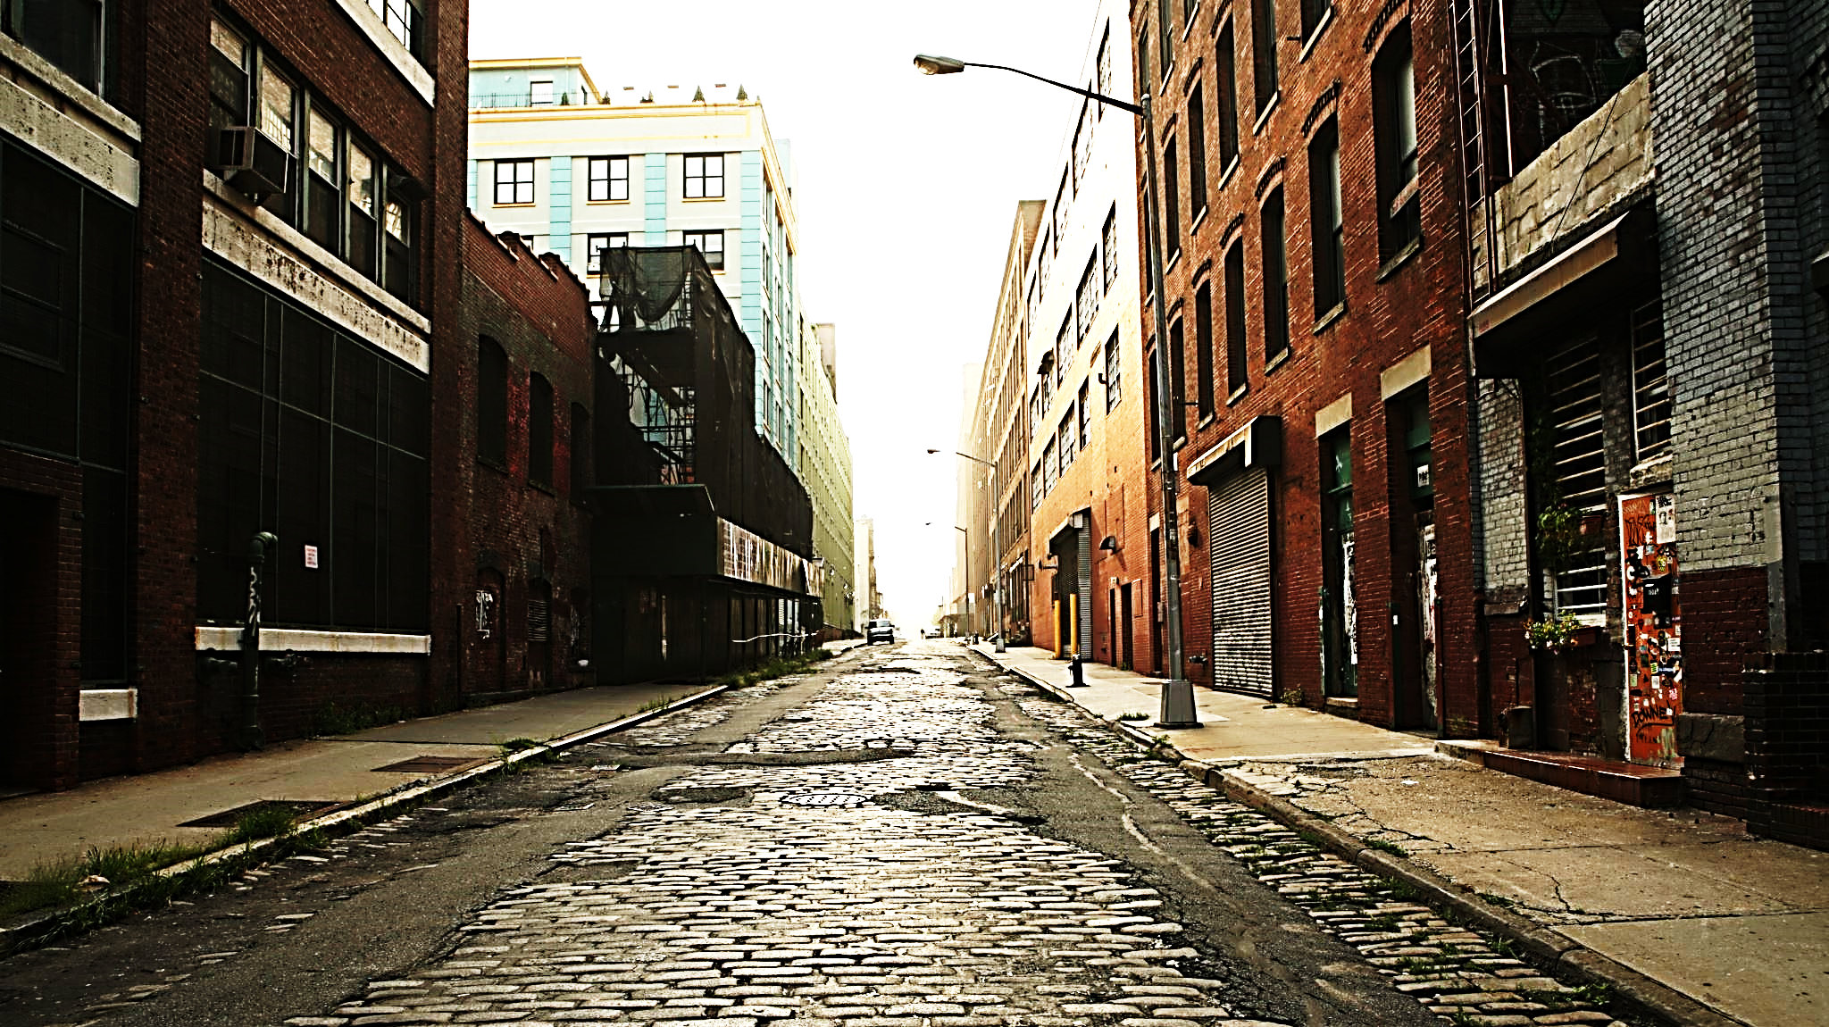
Making Nashville’s Streets Safer
Where are Crashes Happening and What May be Causing Them?
Notes:
Welcome to my capstone presentation! We’re taking a look at how we can use data that wouldn’t otherwise be associated with traffic and roadway design to hopefully provide some insight into what may be contributing to motor vehicle accident type and frequency.
Specifically, we’re exploring a possible correlation between crashes and 311 complaints.

Slide 2
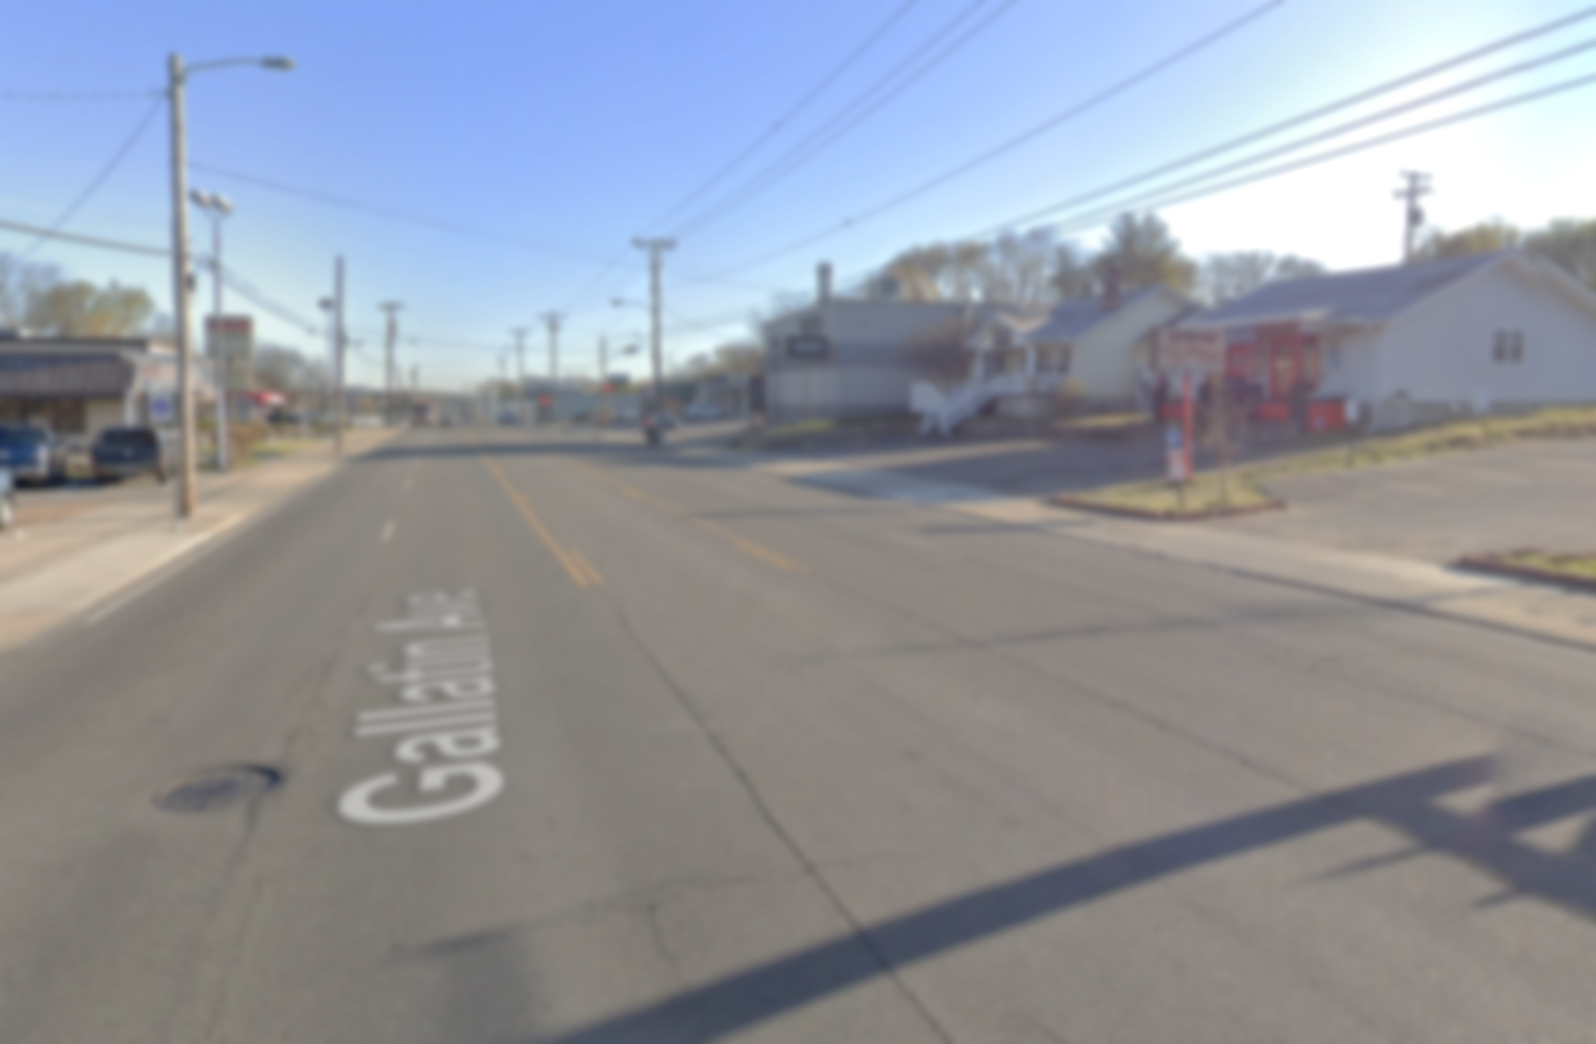
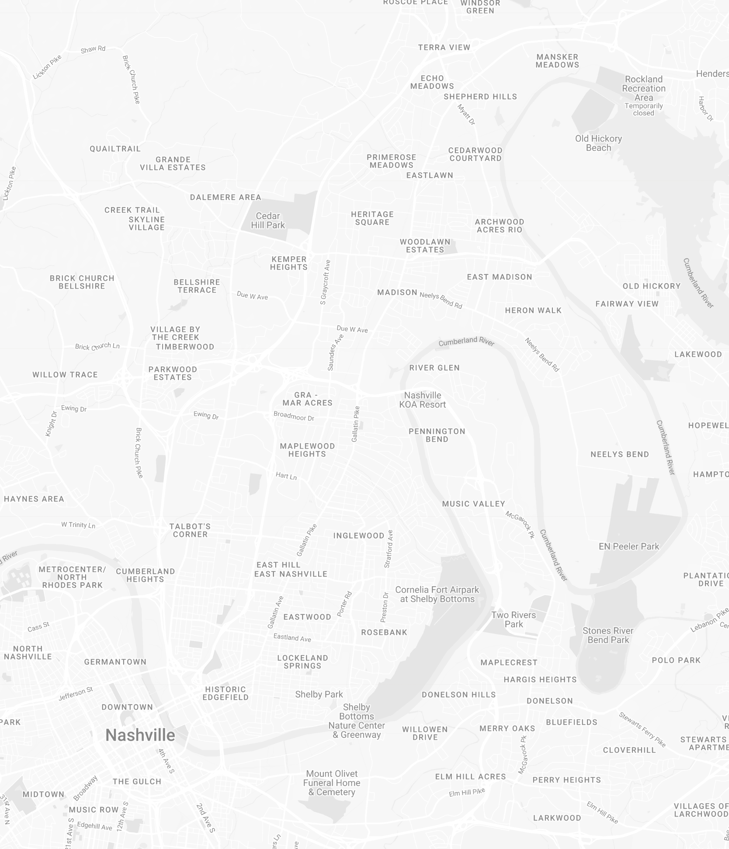
Inspiration / Context
Vision Zero Initiative
East Nashville’s Walkability
Outdated Urban Planning Practices
Study Corridor:
Typically Five Lanes
Two travel lanes each direction
One center two-way left turn lane
Total roadway width in background photo: ~60 ft
Lots of curb cuts / driveways
Notes:
While there is an incredible amount of data covering the entire city of Nashville, I wanted to focus my analysis on one stretch of road that I know well, to be able to do a deeper dive into the data. The corridor we’re going to be looking at today is Main Street, Gallatin Avenue, and Gallatin Pike, which runs from Nissan Stadium to the county line just north of the Rivergate Mall in Madison. A study was recently conducted along Main Street & Gallatin Avenue as part of Vision Zero, which is a nationwide program with a goal of zero traffic-related deaths and serious injuries. Having spent the majority of my current career working on urban roadway design, I have several thoughts on how best to make this corridor safer and more efficient, but I want to see whether or not the data supports it.

Slide 3
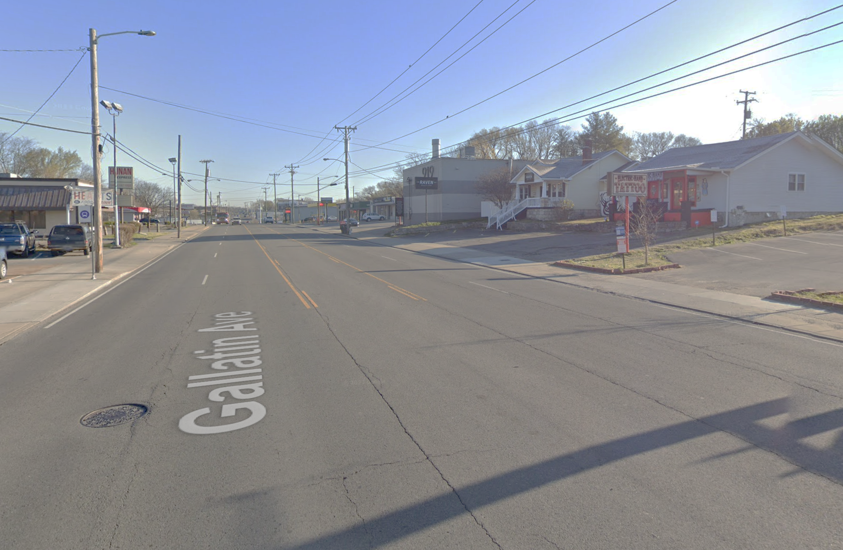
Inspiration / Context
Wide, Straight, Pavement
Lots of development (new construction and existing renovations)
Curb cuts
Two-Way Left Turn Lane
Two Southbound travel lanes
Two Northbound Travel Lanes
Notes:
For some quick context, you can see in this image from Google Street View what I think is a pretty typical view of what’s going on throughout the corridor.
The whole corridor is a long, wide expanse of pavement with a generally very straight alignment that invites much higher speeds than the posted 35-40 mph. There is also a two-way left turn lane in the center to serve the almost constant driveway access to businesses
(I see 6 driveways in this picture alone, and they take up almost all of the curbline on both sides).
Last, I also wanted to bring up the amount of development in the area – something that’s not unique to Nashville and certainly not even to this part of Nashville, but something that has the potential to generate a lot of short-term congestion through road closures and long-term capacity issues as additional traffic is generated from businesses that better fit the area.

Slide 4
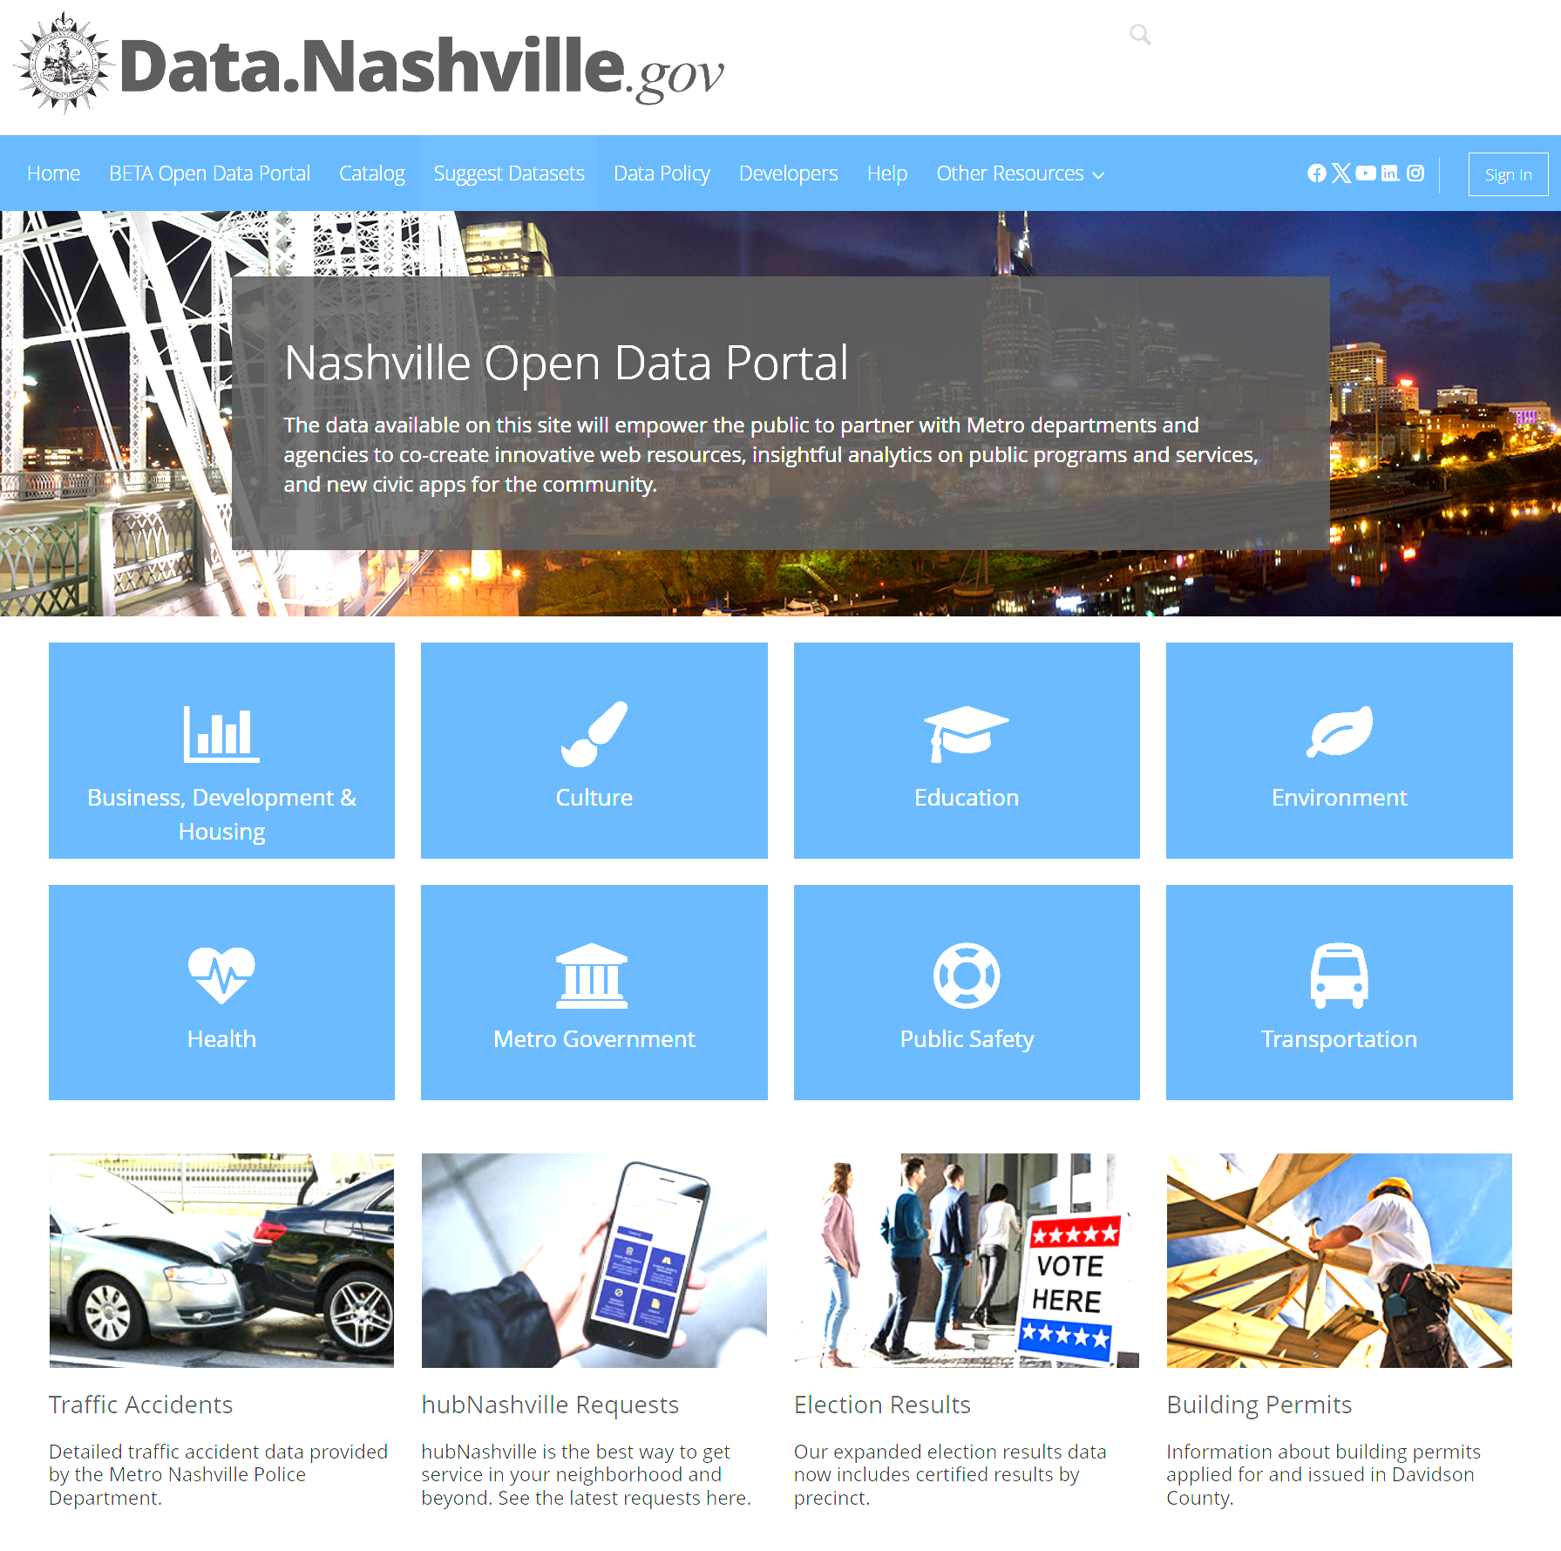
Data Collection
Source: Nashville Open Data Portal
Included in Analysis:
Crash Reporting
311 Requests
Active Construction
Building Permits
Right-of-Way Occupancy Permits
Short Term Rental Properties
Pedestrian Signal Inventory
Notes:
All of the data presented in this analysis has been pulled from Nashville’s Open Data Portal. Not all of the datasets here are presented on the slides because after looking at them, I didn’t find anything significant for the purpose of this analysis.
I looked at:
- crash reporting from Metro Nashville PD
- 311 requests that have come in through Hub Nashville
- active construction permits, both building permits and construction within the roadway
- a database of permits granted for short term rentals & AirBNBs,
- and finally an inventory of traffic signals throughout the city and the availability/compliance of pedestrian facilities at these locations.
In an effort to keep this analysis dynamic and able to be applied to any road segment in the city, all of the data was gathered in Python through the portal’s API documentation (using the Soda API), cleaned and filtered to only include the analysis area.
From there, PowerBI was used to generate the visualizations in this presentation. This way if someone wanted to do a similar study for another area, all they would have to do is adjust the filter parameters in the Python code and reload the visualizations in PowerBI.

Slide 5
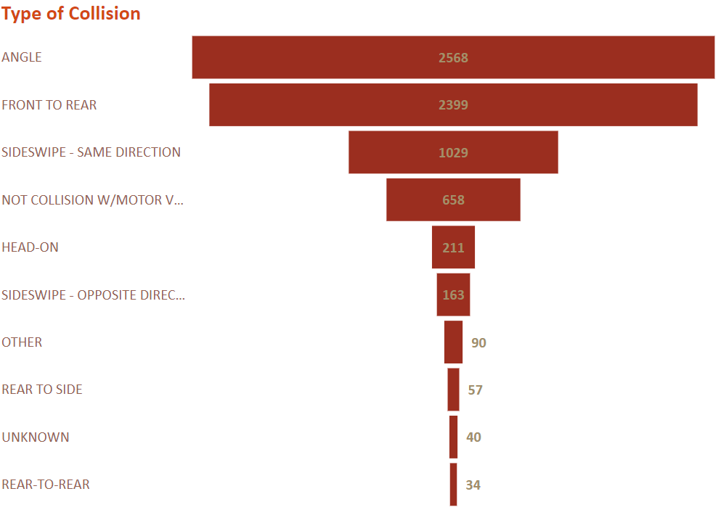
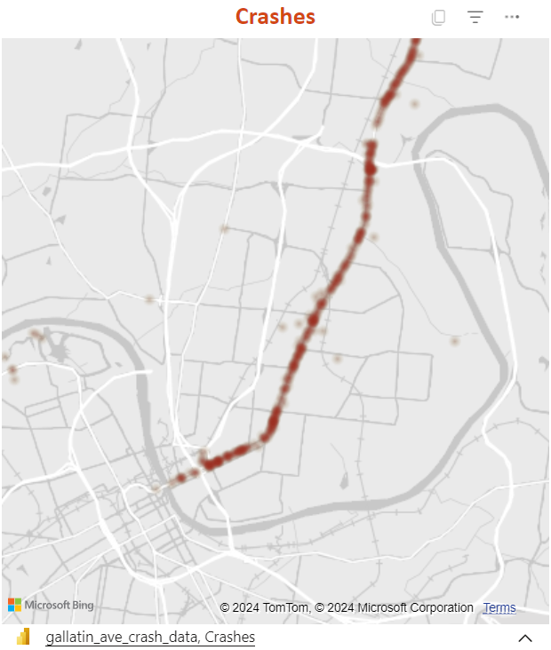
Crash Analysis
Notes:
The key dataset here is the crash reports, so let’s start there. On the left is a heatmap of the location data for each crash. I’ve zoomed it in on the Main Street section of the corridor to highlight how clustered these crashes tend to be around intersections.
It’s still a little difficult to see at this scale, but these “hot spots” will be useful later on when start comparing location data in other datasets.
On the right is a breakdown of the type of each collision noted on the police reports, and on a road like this with that center two-way left turn lane, the high number of angle crashes makes sense, as speeds tend to be high and it can be difficult to judge whether there’s a sufficient gap to turn.
The city’s Vision Zero study found that there are a significant number of short car trips between businesses along the corridor, likely because it can be extremely difficult to cross the street as a pedestrian. This, combined with the near-constant driveways along the sidewalks, means drivers are frequently turning onto Gallatin form one driveway and having to almost immediately get themselves into that center turn lane, and if you’re stopping to wait for traffic to pass at any point during that process, you leave yourself at risk of not only those angle collisions, but being rear-ended or sideswiped depending on where in the roadway you stopped.

Slide 6
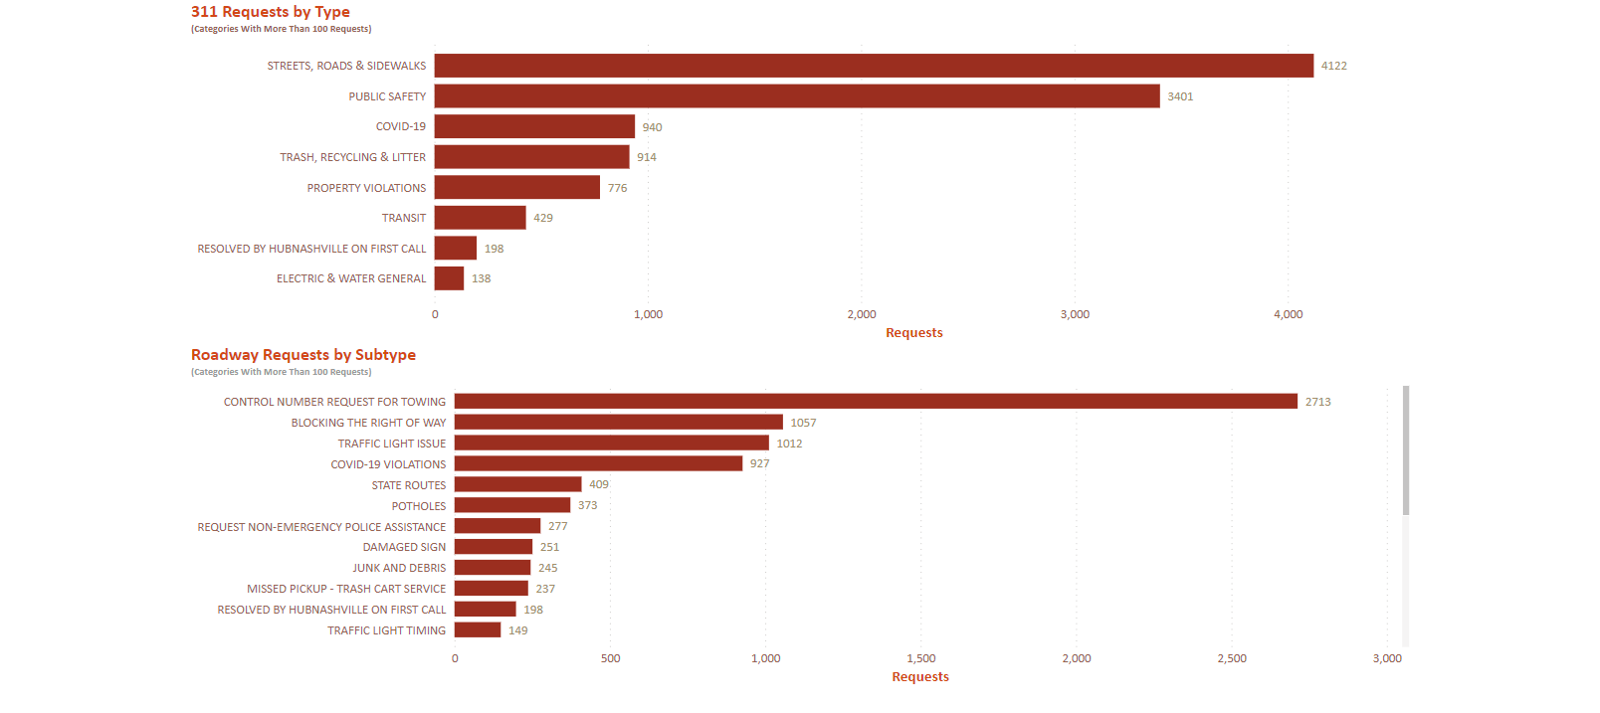
311 Requests
Notes:
The dataset I found most insightful out of the ones I looked at was the city’s 311 requests.
Filtering the data for just calls made regarding something in the vicinity of the corridor, we can see that the vast majority of complaints made were categorized as “Streets, Roads, & Sidewalks”, with “Public Safety” being the next most frequent complaint and everything else being less than a quarter of that street and sidewalk category.
So, it would seem that people in the area are generally most concerned with poor road conditions, and looking at the chart on the bottom, which shows the subcategories within that main Street and Sidewalk category above, we can see what exactly about the roads are people concerned with.
“Blocking the right-of-way” could be any number of things and I don’t have enough detail in the data to drill down further there, but what I notice here though, is the amount of requests related to traffic lights. I know the city recently implemented changes to the signal timing at one of the intersections along the corridor and not long after I witnessed a crash there.
The fact that the second-most frequent complaint here is “traffic light ISSUE” suggests that there may be a maintenance backlog here and short of hiring additional staff to fix a short-term problem, I don’t know what else the city can do to address this.
I bring all this up to say that with the frequency that traffic lights seem to be having issues, I don’t believe that adjusting signal timing is an appropriate solution to address road safety.
Another somewhat high-volume category is potholes. I’m sure you know at least one person who’s had a tire blown out or a vehicle damaged from hitting a pothole in the road. I think a big reason why this is not higher on the list is how seasonal the issue is: potholes are caused by the shrinking of the top layer of asphalt in colder weather, where it breaks the bond between itself and the lower layers and crumbles away.

Slide 7
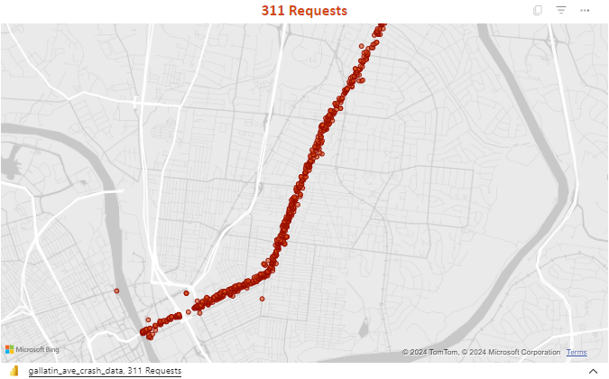
Crashes Vs 311 Requests
Pedestrian Signal Inventory:
35 signalized intersections
24 do not have pedestrian facilities on at least one corner
33 were not ADA-compliant in at least one area
311 Requests:
Similarly clustered around intersections
Notes:
Speaking of traffic signals, I alluded to earlier that the Vision Zero study found that there is a distinct lack of pedestrian facilities along the corridor (It’s worth noting that they only studied up to Briley Parkway where Gallatin Avenue becomes Gallatin Pike).
Looking at the pedestrian signal inventory, there were 35 intersections inventoried, and almost all of them were marked non-compliant with the ADA (or Americans with Disabilities Act) in at least one area.
These are things like, “is the push button at an appropriate height for a person in a wheelchair to use it?”, “are there detectable warning strips to alert blind people that they’re entering the roadway?”
Getting back to 311 requests, what you’re seeing on the map on the right are the mapped locations of each roadway-related 311 request.
It’s difficult to tell on the map but zooming in, these also seem to be clustered around intersections, much like the crash heatmap.

Slide 8
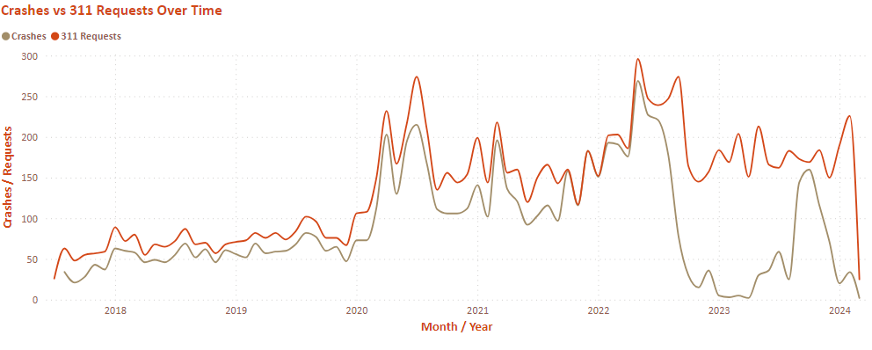
Crashes vs 311 Requests
Notes:
Here we see an interesting correlation between crashes and 311 requests over time.
Note that again these are just 311 requests related to roadway and sidewalk conditions.
You can see that when aggregated by month and year they follow very similar trends.
It’s interesting that after July of 2022, crashes dropped significantly and picked back up in October of 2023 while 311 requests remained stable.
I looked at that time period further and the only thing that jumped out at me about the 311 requests was that for that time, “Public Safety became far and away tehe most common category, but I wasn’t able to find an explanation for why tat dfference is there.
Other than that, overall we can see that crashes and 311 complaints have been slowly rising over the roughly 5 year period we have data for, with the sharpest increase coming right at the start of the pandemic in April of 2020.
While not all of these crashes involved serious injuries or death, this is what Vision Zero is about: finding what went right in that period at the end of 2023 and finding ways to keep those crash numbers where they were then.

Slide 9
What Have We Learned?
Both crashes and 311 requests tend to be clustered around intersections, and both follow similar trends over time.
(August 2022 to August 2023 is an unexplained anomaly)
The solution is space allocation and access management, not traffic signal maintenance
(Although signal maintenance is still necessary)
Notes:
So what have we learned from all of this?
The key correlation here that I think could use some deeper analysis is between 311 complaints and motor vehicle crashes.
The frequency of crashes and frequency of roadway-related 311 complaints seem to follow a similar pattern over time and while the pattern itself is likely not significant, a deeper dive into the specifics of each crash report relative to 311 complaints in the area could help identify what was going on in the area at the time of the crash.
I also remain skeptical that traffic signal maintenance, including retiming of lights, is an adequate way to mitigate the safety concerns along this corridor while still keeping traffic flowing.
Since there are a large number of angle and sideswipe crashes, I think the larger issue here is the amount of changing lanes people have to do to get where they’re going, and the amount of available places where someone might be turning into or out of.

Slide 10
Thank You
Notes:
I’d like to thank you for your time and I’m happy to answer any questions you have!

